Slide 1
Investigating Matter and Change
A Matter of Degrees

Slide 2
Key Understandings
Matter has physical properties that can be observed and measured.
What is temperature?
How is temperature measured?
Why is it important to be able to read a thermometer correctly?

Slide 3
Misconceptions
Students may think materials can only exhibit properties of one state of matter.
Students may think that water disappears when it evaporates.

Slide 4
Temperature
A measure of how hot or cold something is.

Slide 5
Energy
The ability to change matter.

Slide 6
Water Vapor
The gas state of water.

Slide 7
Evaporation
The process of changing from a liquid to a gas.

Slide 8
Condensation
The process of changing from a gas to a liquid.

Slide 9
Where have you seen a thermometer used before?

Slide 10
Scientist use temperature and changes in temperature to describe and learn more about matter.

Slide 11
Different Types of Thermometers

Slide 12
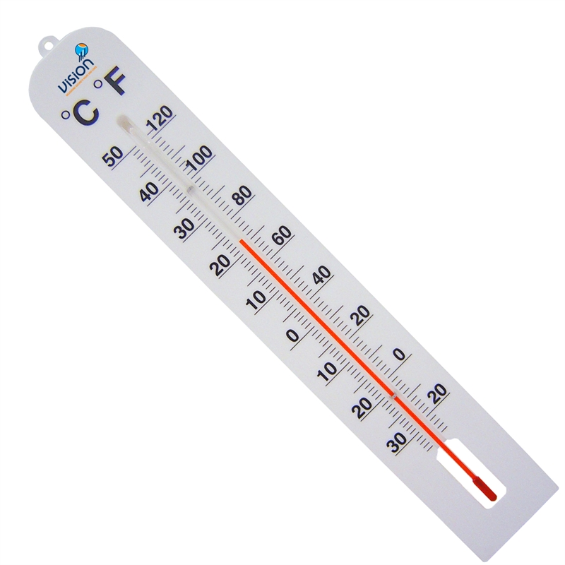
Comparison of the Celsius and Farenheit Scales Thermometer

Slide 13
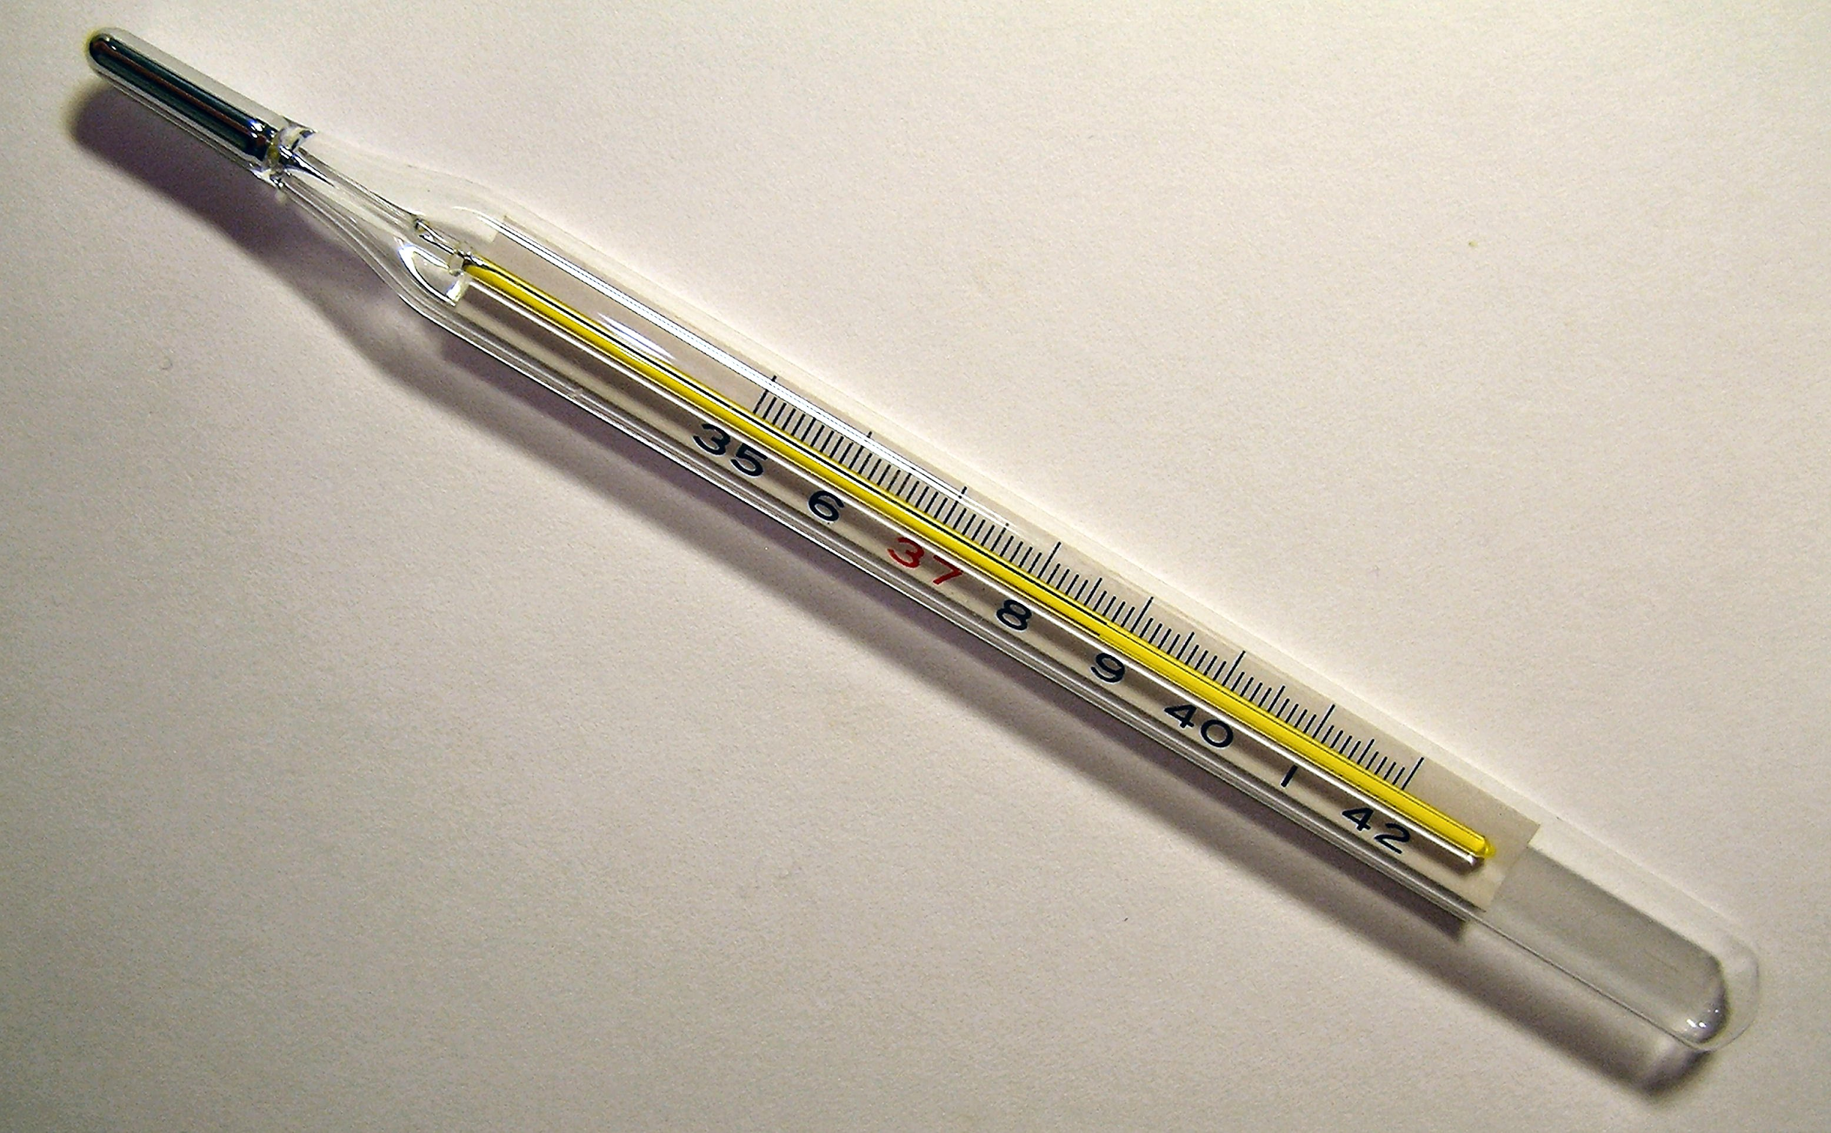
Clinical Mercury in Glass Thermometer

Slide 14
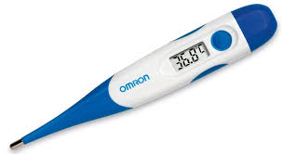
Digital Thermometer

Slide 15
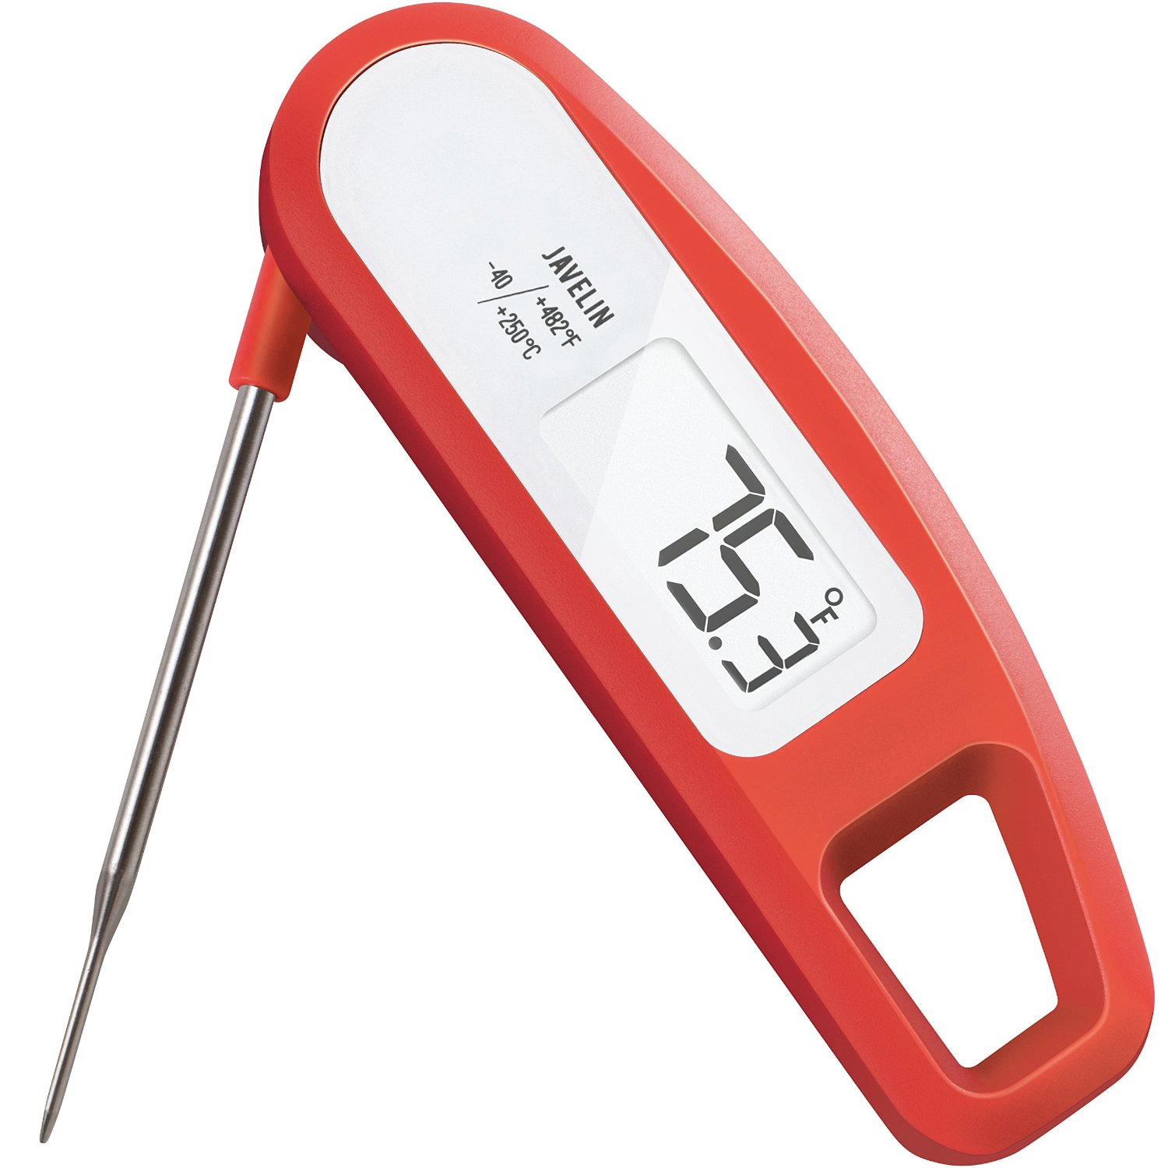
Food Thermometer

Slide 16
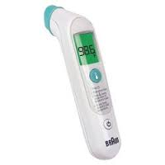
Exergen Temporal Scanner

Slide 17
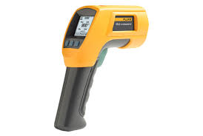
Infrared Thermometer

Slide 18
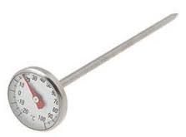
Bi-Metallic Stem Thermometer

Slide 20
Estimate what you believe the room temperature might be at this moment.

Slide 21
Fahrenheit (℉) and Celsius (℃)
These two symbols are abbreviations for Fahrenheit and Celsius.
Scientist typically measure temperature in ℃.

Slide 22
Complete the handout: Reading Scales

Slide 23
End of Activity Questions
What tool have we used today that can help us gather more information about matter?

Slide 24
End of Activity Questions
Thermometer

Slide 25
End of Activity Questions
What are two different scales and units used to measure temperature?

Slide 26
End of Activity Questions
℃ and ℉

Slide 27
End of Activity Questions
Why is it important to be able to read a thermometer correctly?

Slide 28
End of Activity Questions
Answers will vary.

Slide 29
End of Activity Questions
Why is it important for doctors and nurses, farmers, cooks, pilots, and parents to accurately read a thermometer?

Slide 30
End of Activity Questions
Answers will vary.

Slide 31
Interactive Fun Online
Interactive Thermometer
https://www.mathsisfun.com/measure/thermometer.html
Thermometer Quiz
Thermo Quiz

